Slide 2
Improving app health with crash analytics
Katie Maertens
2-138

Slide 3
Agenda
Importance of customer feedback.
Desktop app reports.
Drilling further with automation.
New features.
Windows Store reports.

Slide 4
Importance of customer feedback

Slide 5
Customer feedback
Windows Error Reporting has existed since Windows XP.
Feedback is received from millions of users.
We want you to have access to the same information.

Slide 6
Global impact
Understand your customer’s experience.

Slide 7
Tapping into the data

Slide 8
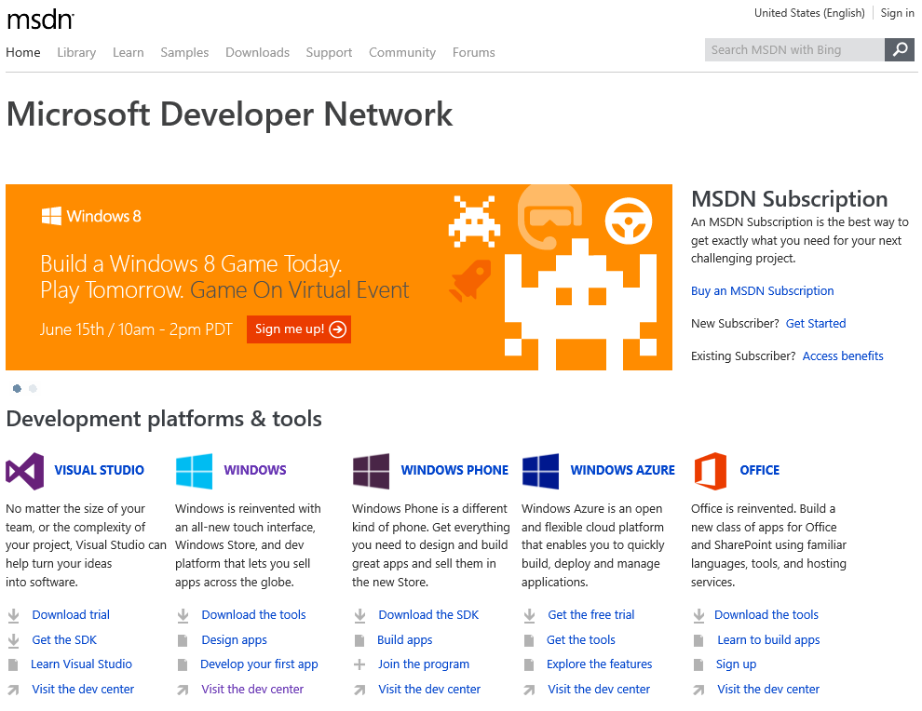

Slide 10
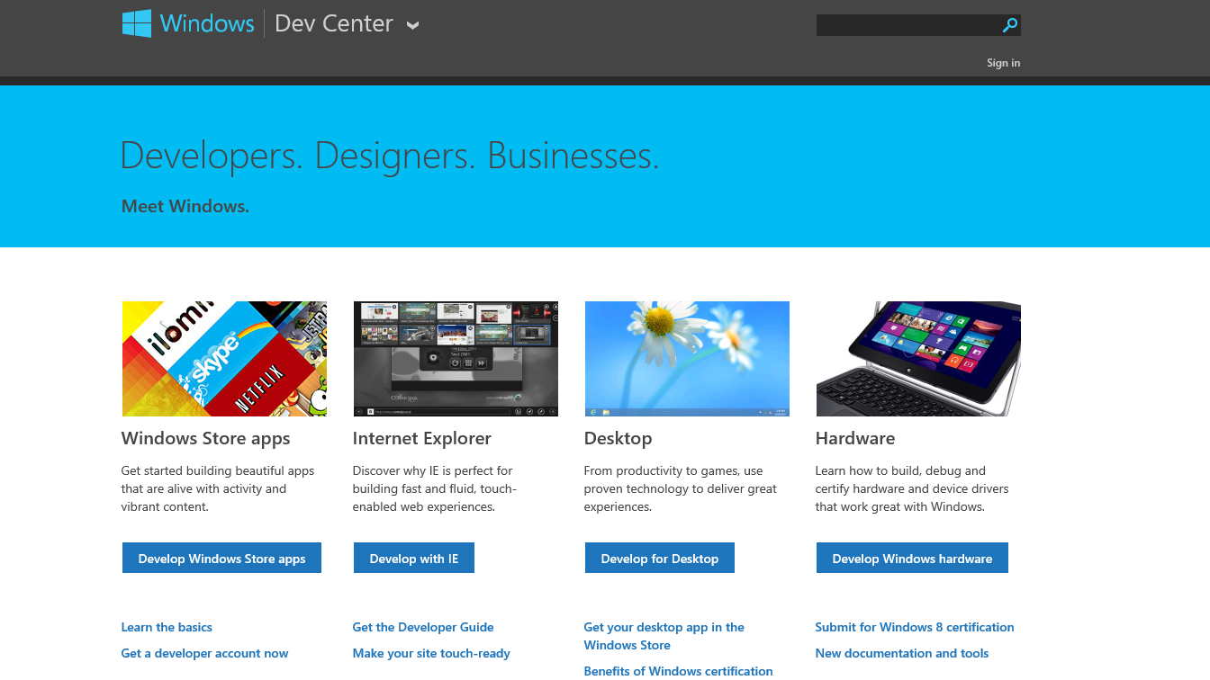

Slide 12
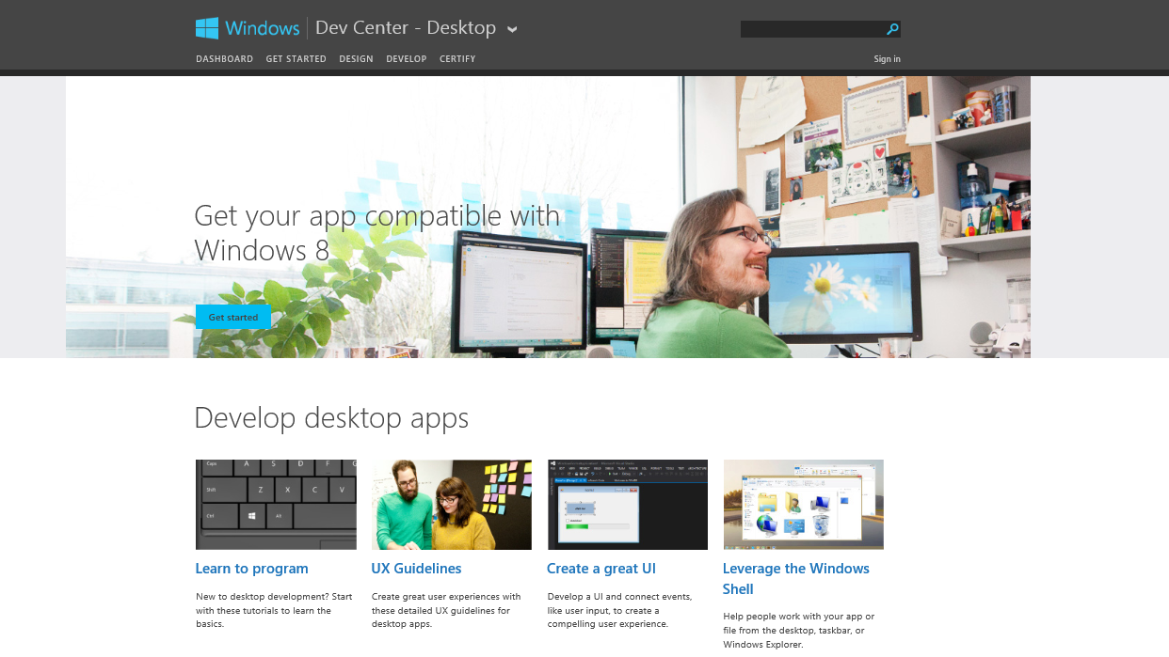

Slide 14
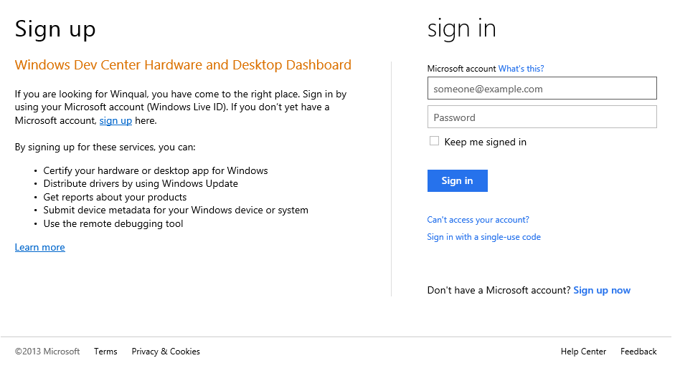

Slide 15
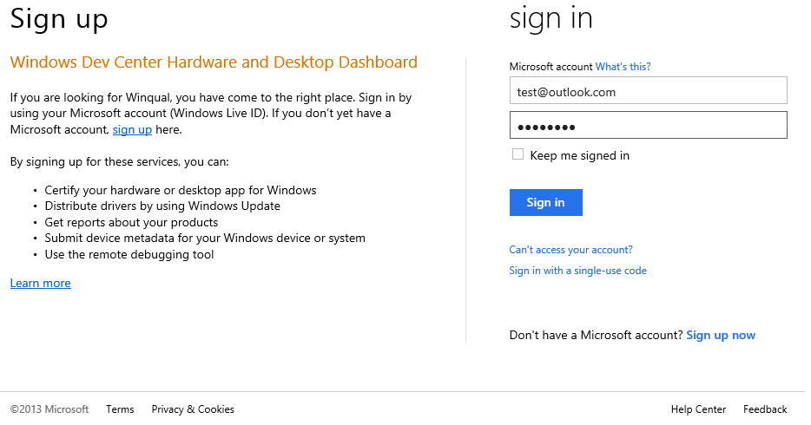

Slide 16
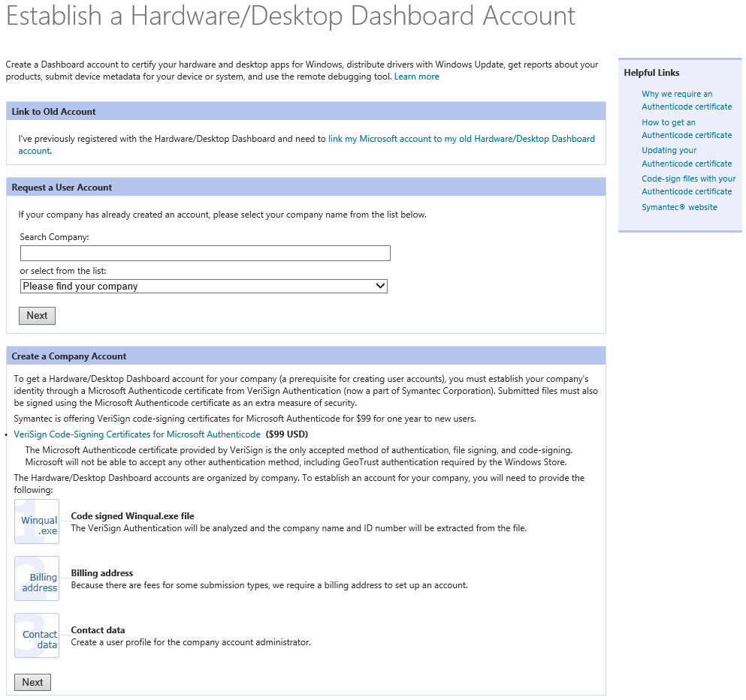

Slide 17
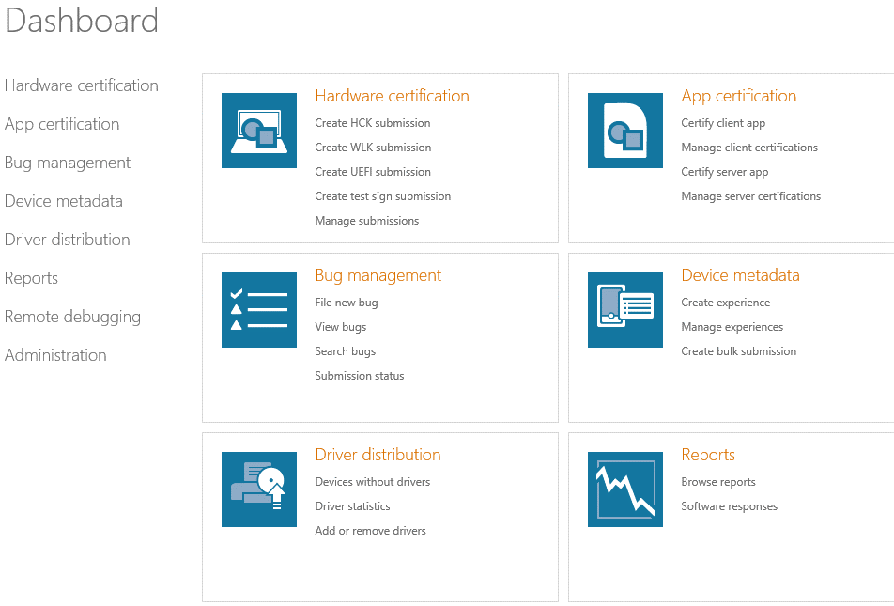

Slide 19
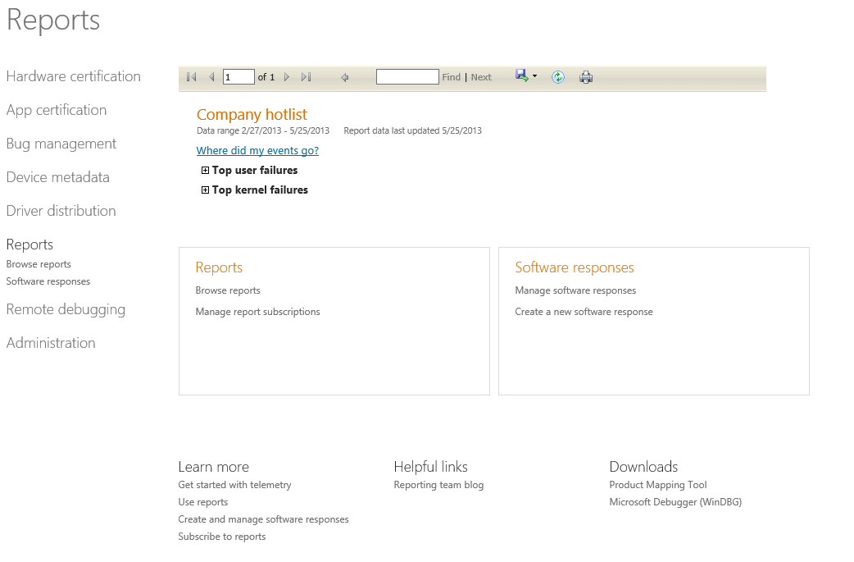

Slide 21
Product mapping tool

Slide 22
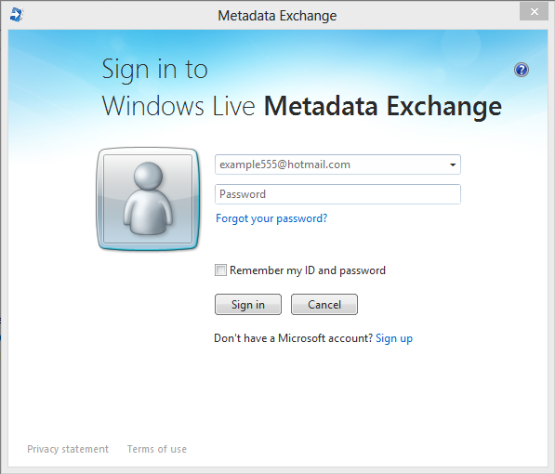

Slide 23
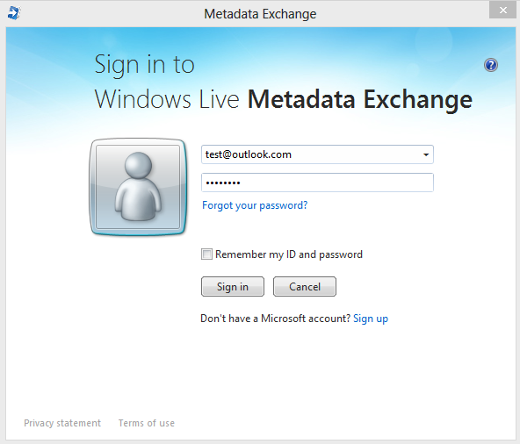

Slide 24
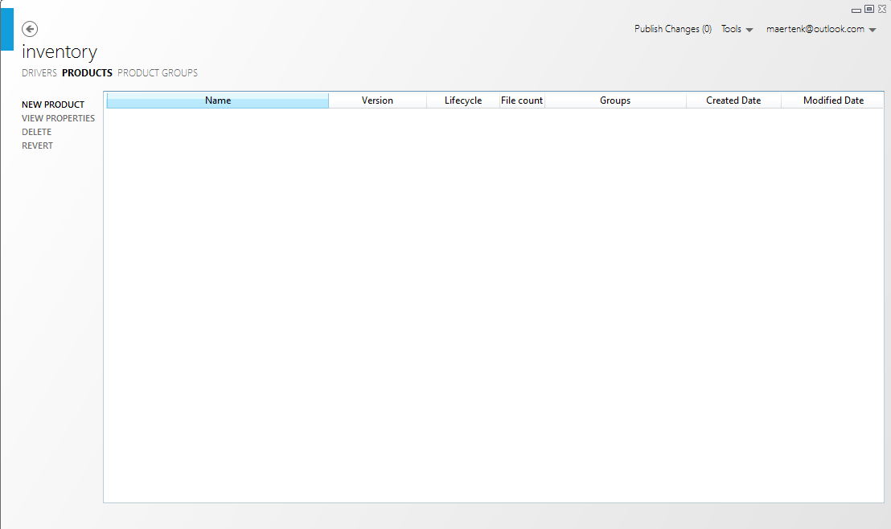

Slide 26
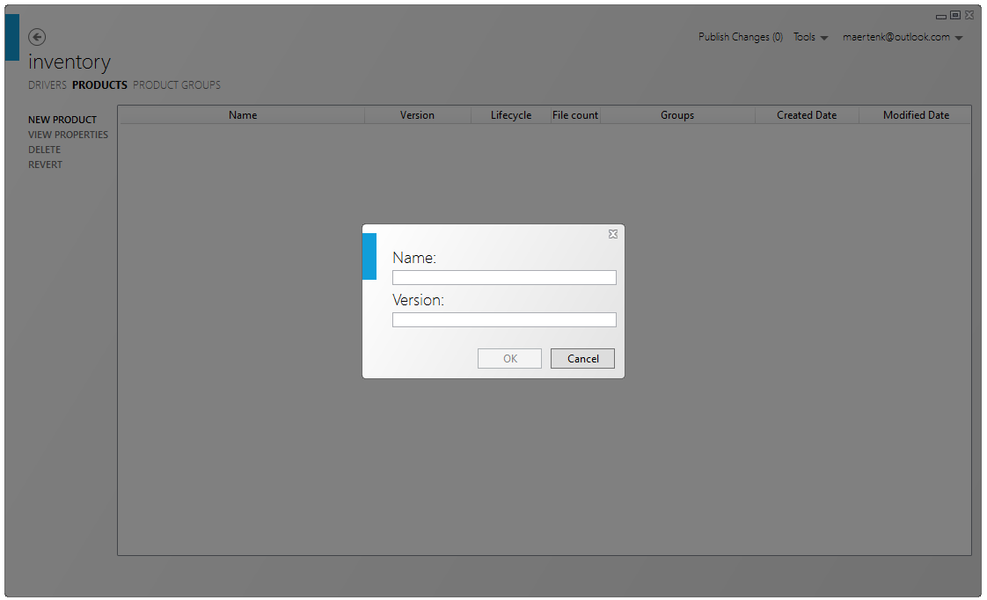

Slide 27
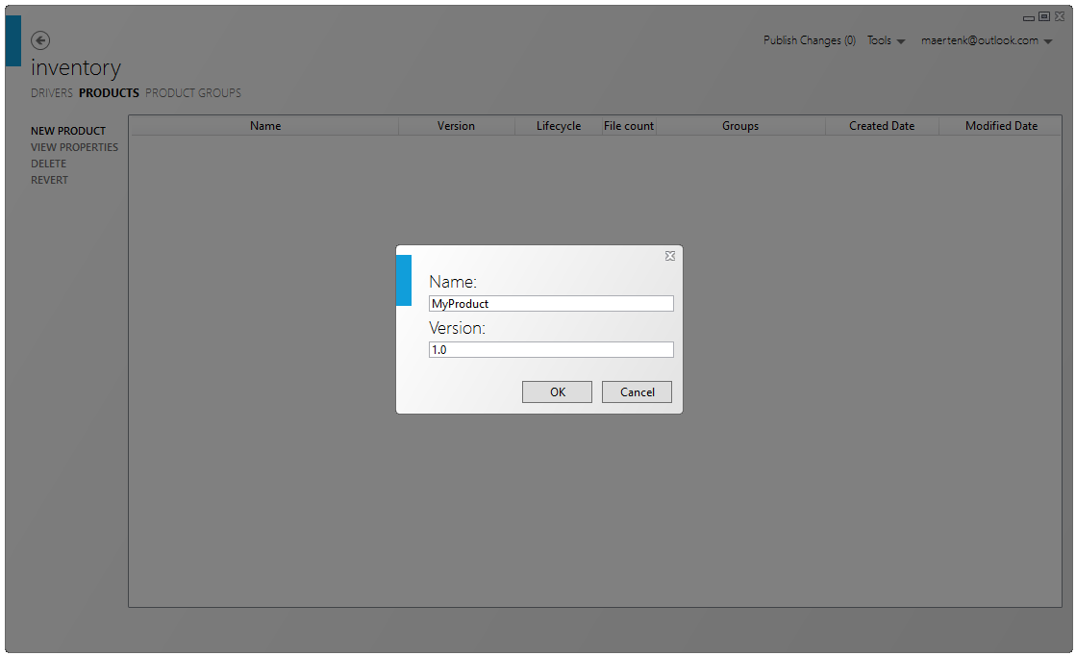

Slide 28
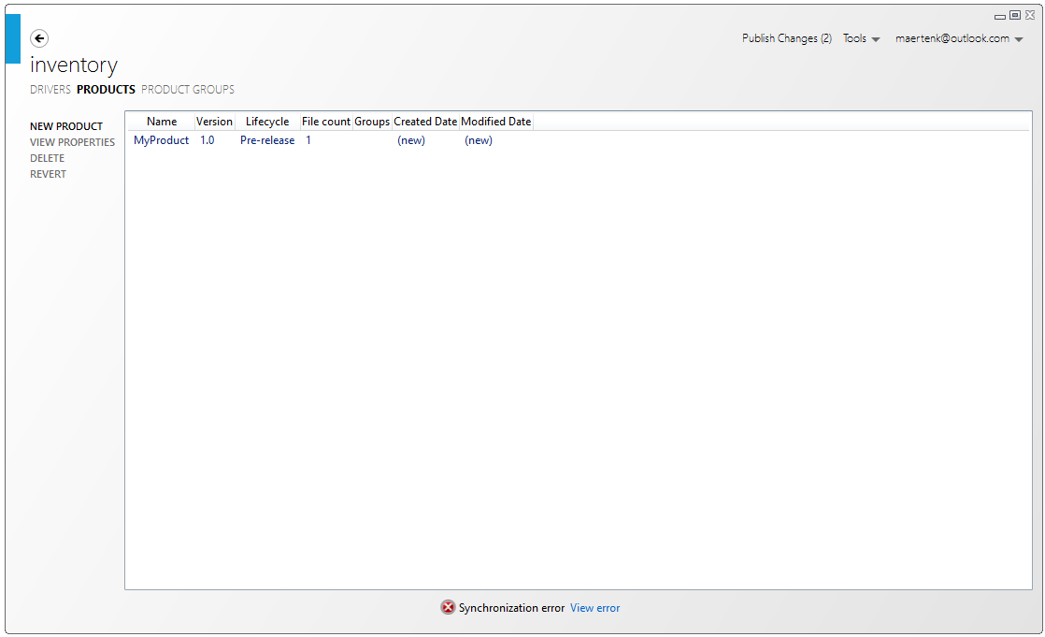

Slide 30
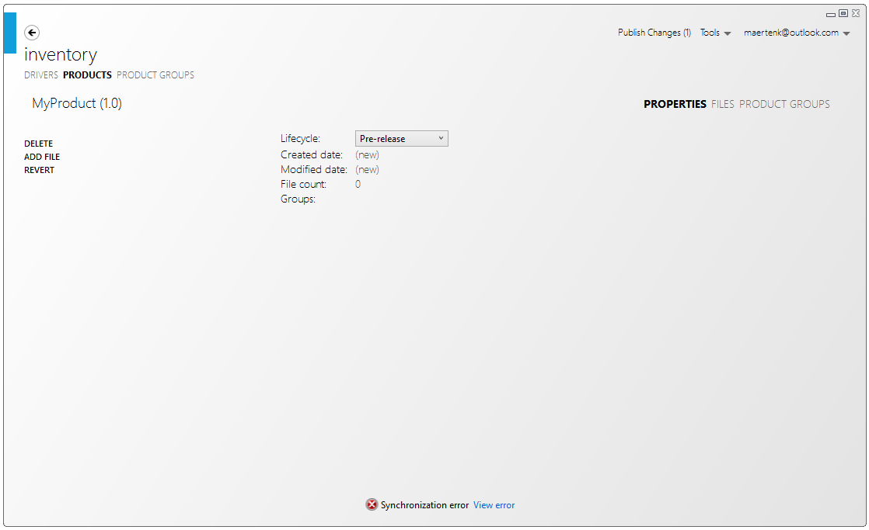

Slide 32
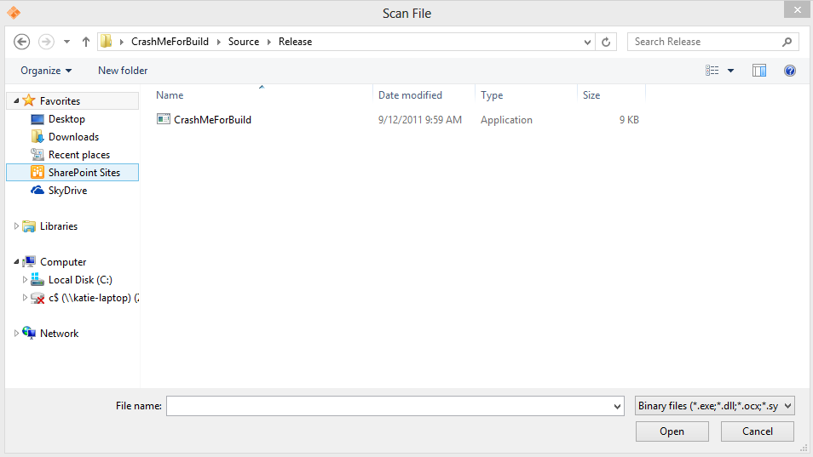

Slide 34
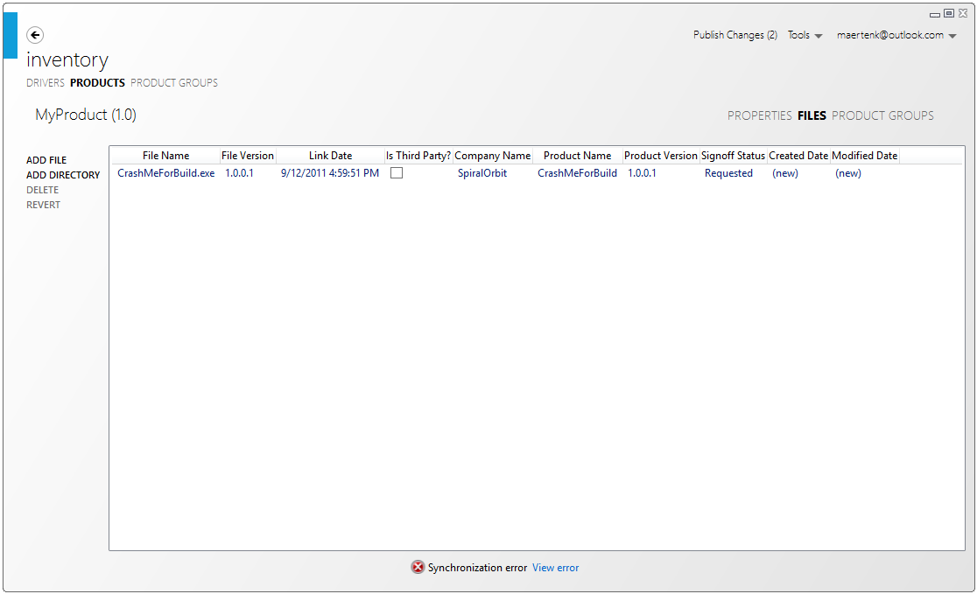

Slide 36
Reports

Slide 39
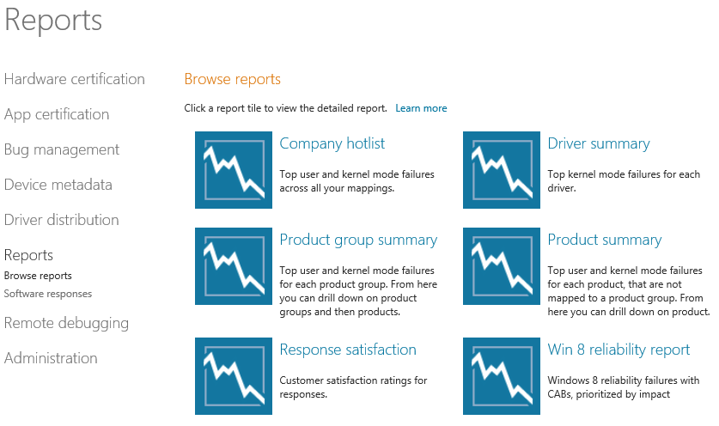

Slide 41
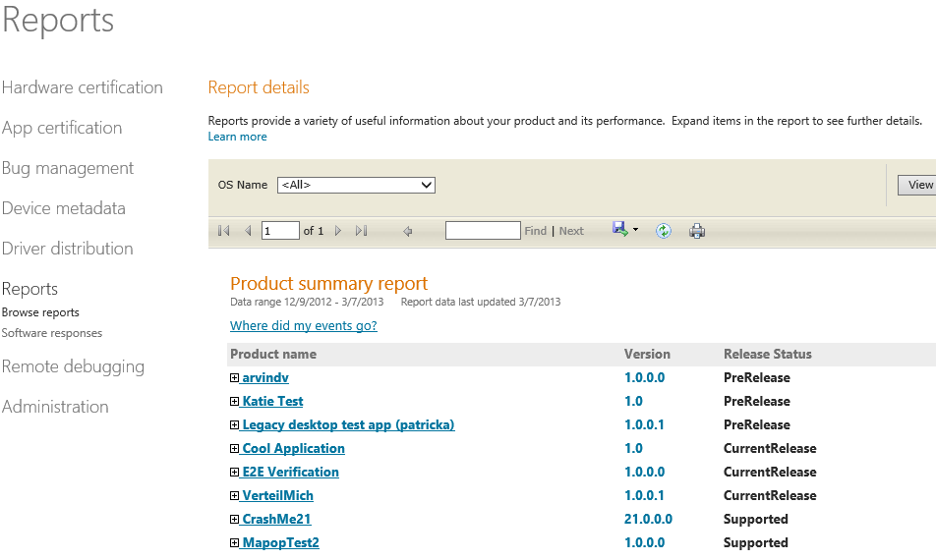

Slide 43
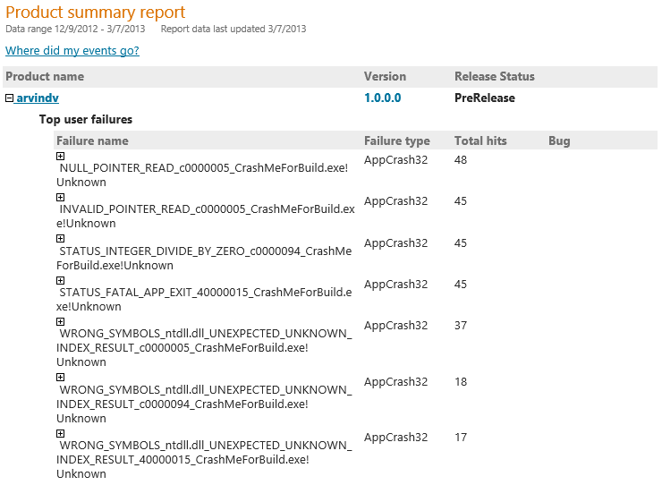

Slide 45
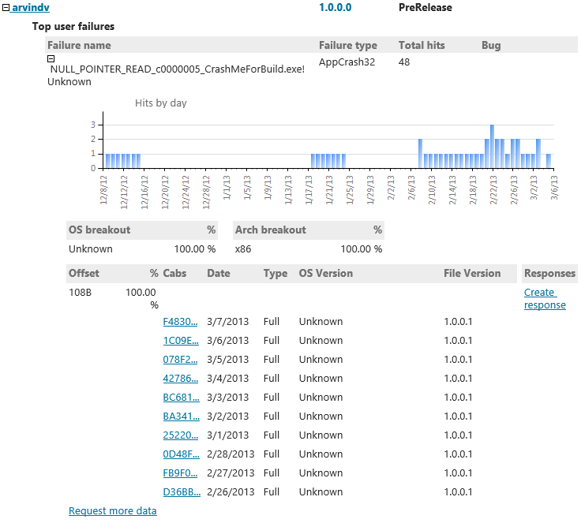
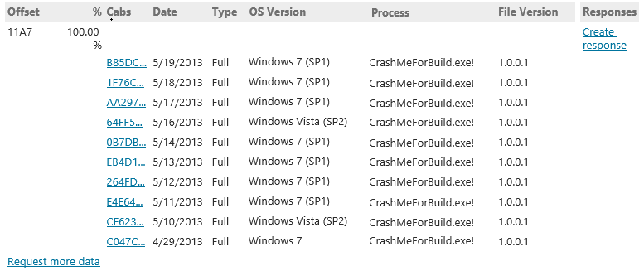

Slide 47
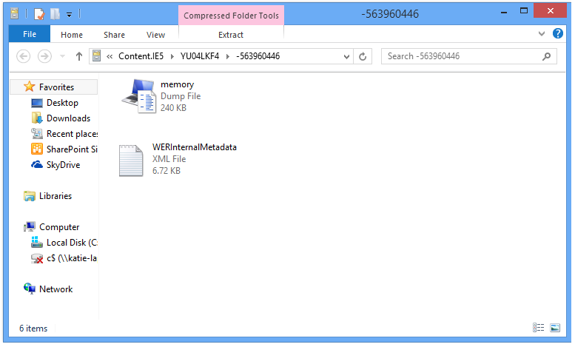

Slide 49
Demo: CAB debugging
Visual Studio

Slide 50
Demo: Drilling further with automation
Report API

Slide 51
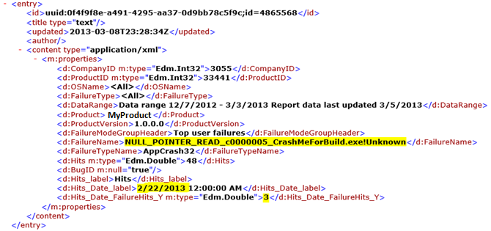
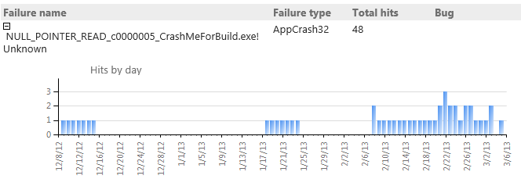

Slide 53
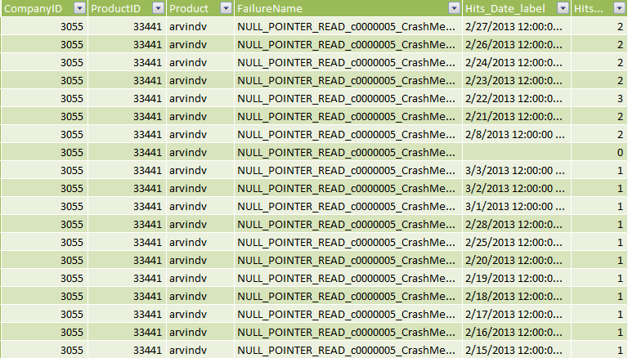
Leverage Power Pivot

Slide 54
Leverage Power Pivot

Slide 55
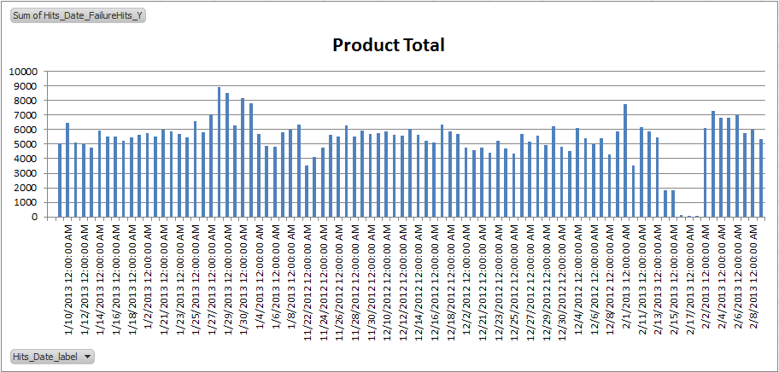
Leverage Power Pivot

Slide 56
Programmatic flow of Report API
Report list URL – gives you list of reports.
/ReportingService/ReportingService.svc/Reports
Feed list URL – gives you list of feeds for a report.
/ReportingService/ReportingService.svc/Reports/ReportName
Feed URL – gives you content of the feed.
/ReportingService/ReportingService.svc/Reports/ReportName/FeedName

Slide 57
Get report list code sample
System.Collections.ArrayList reportNameArray = new System.Collections.ArrayList();
System.Net.HttpWebRequest request = (System.Net.HttpWebRequest)System.Net.WebRequest.Create(REPORT_LIST_URL);
request = GetAuthenticatedRequest(request, username, password);
System.IO.Stream response = request.GetResponse().GetResponseStream();
System.Xml.XmlDocument xDoc = new System.Xml.XmlDocument();
xDoc.Load(response);
System.Xml.XmlNodeList nodes = xDoc.SelectNodes(REPORT_XPATH);
foreach (System.Xml.XmlNode node in nodes)
{
reportNameArray.Add(node.InnerText);
}
return reportNameArray;

Slide 58
New features

Slide 59
New features
Added offset per failure.
Provided extra CAB metadata.
Increased number of CABs available.
Incorporated process information into CAB routing logic.
Enabled filtering on common/shared components.

Slide 60
Windows Store app reports

Slide 63
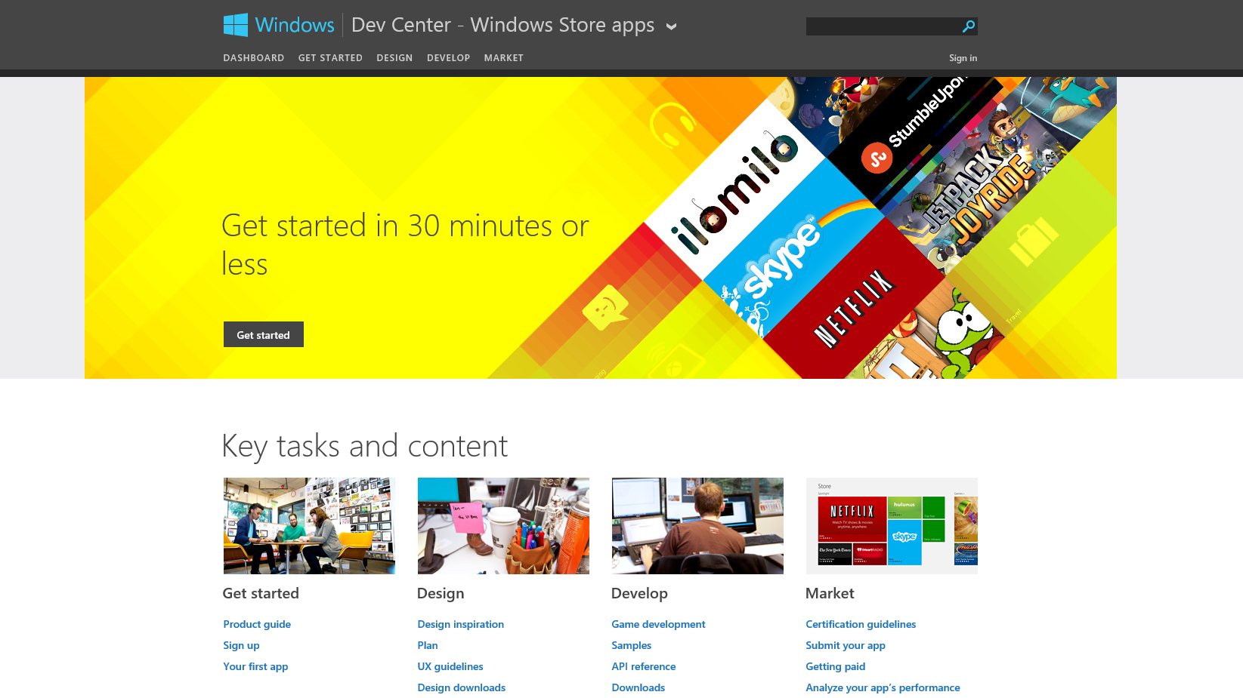

Slide 65
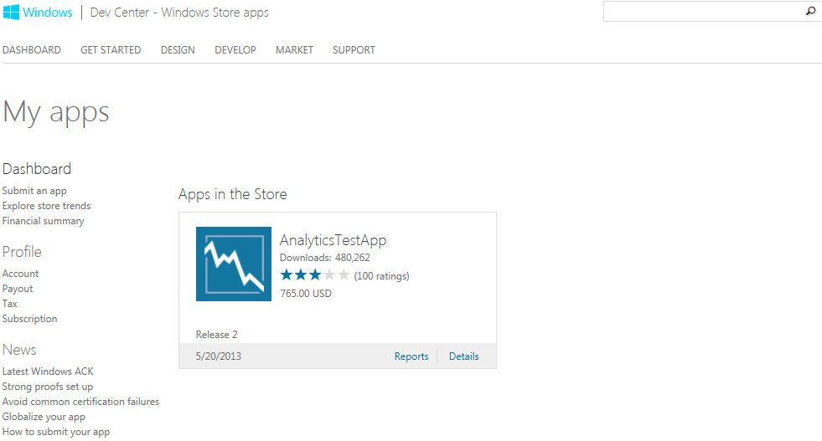

Slide 67
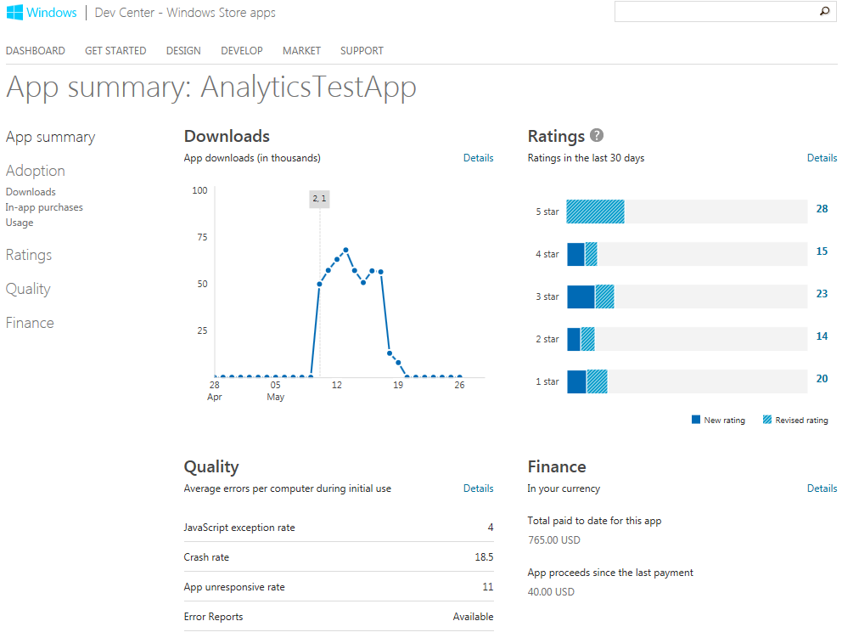

Slide 70
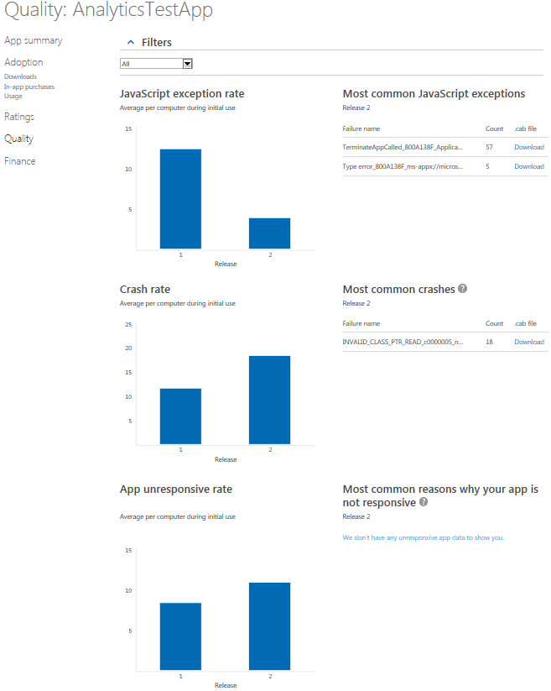

Slide 72
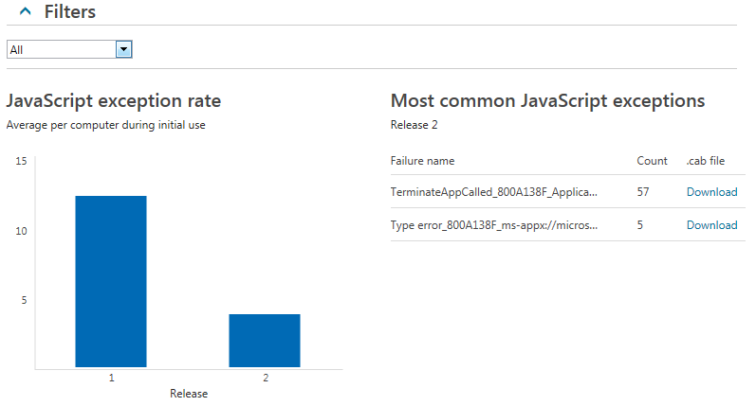

Slide 74
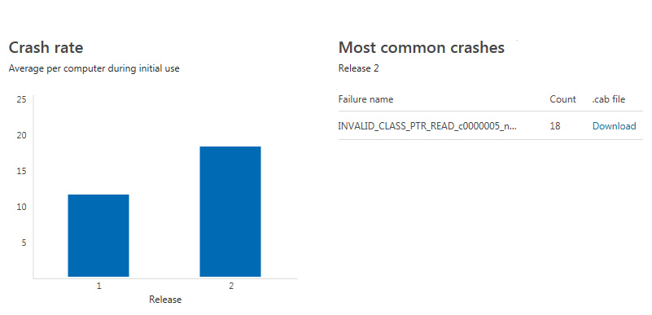

Slide 76
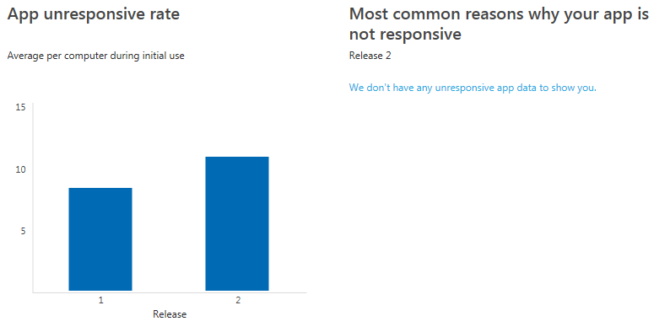

Slide 77
Call to action

Slide 78
Call to action
Leverage MSDN to access your data.
Drive decisions with data.
Map relevant files.
Use automation to provide customization.

Slide 79
Relevant sessions
Making your Windows Store apps more reliable (Session 3–136).

Slide 80
Amaze your customers
Delivering reliable and stable products increases customer satisfaction.

Slide 81
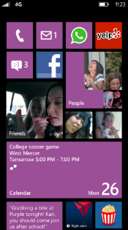
Evaluate this session
Required Slide
*delete this box when your slide is finalized
Your MS Tag will be inserted here during the final scrub.
Scan this QR code to evaluate this session and be automatically entered in a drawing to win a prize!

Slide 82
Thank you

Slide 84
Appendix

Slide 85
Resources
MSDN
Windows Dev Center
Windows Desktop Dev Center
Windows Hardware Dev Center
Windows Hardware and Desktop Dev Center Dashboard
Windows Store Dev Center
Windows Store Dev Center Dashboard
Windows Error Reporting Service Blog
Windows Store Blog
How Windows Error Reporting Collects and Classifies Reports
White Paper on the Report API for Automation

Slide 86
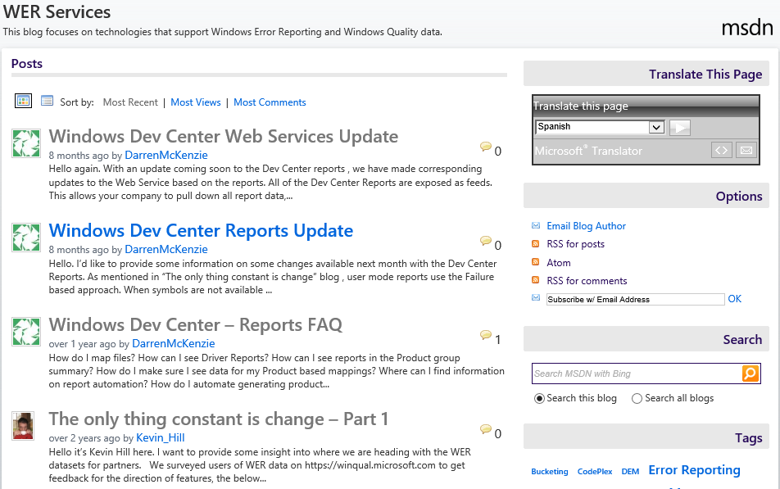

Slide 87
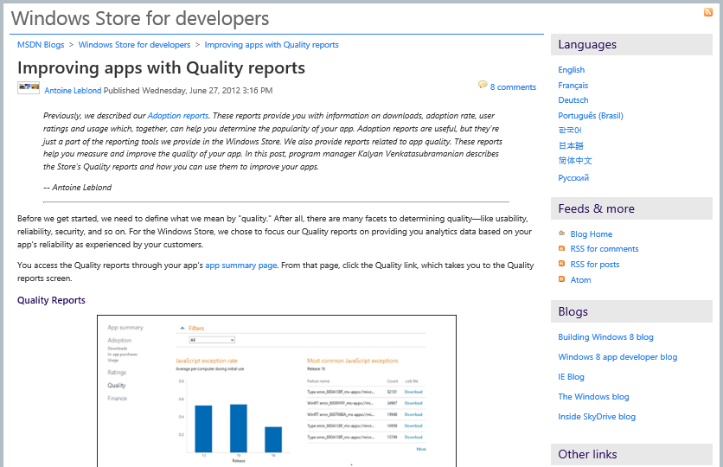

Slide 88
CAB debugging Demo: Visual Studio

Slide 89
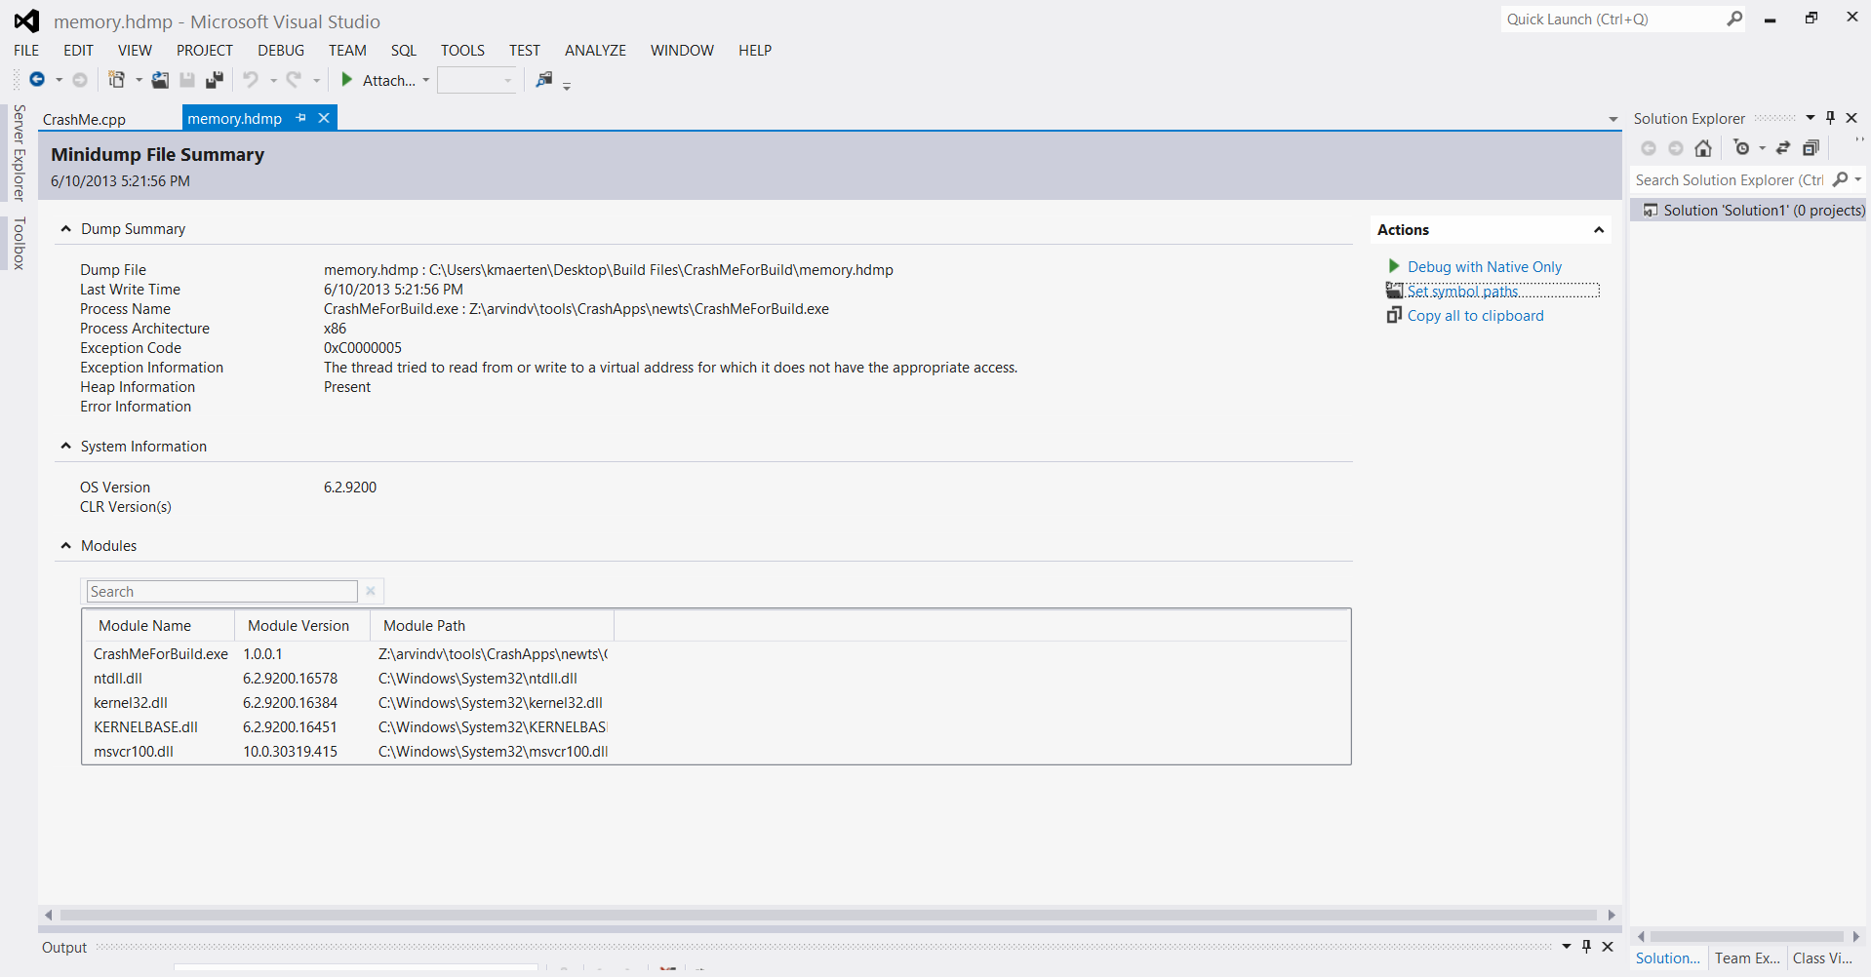

Slide 91
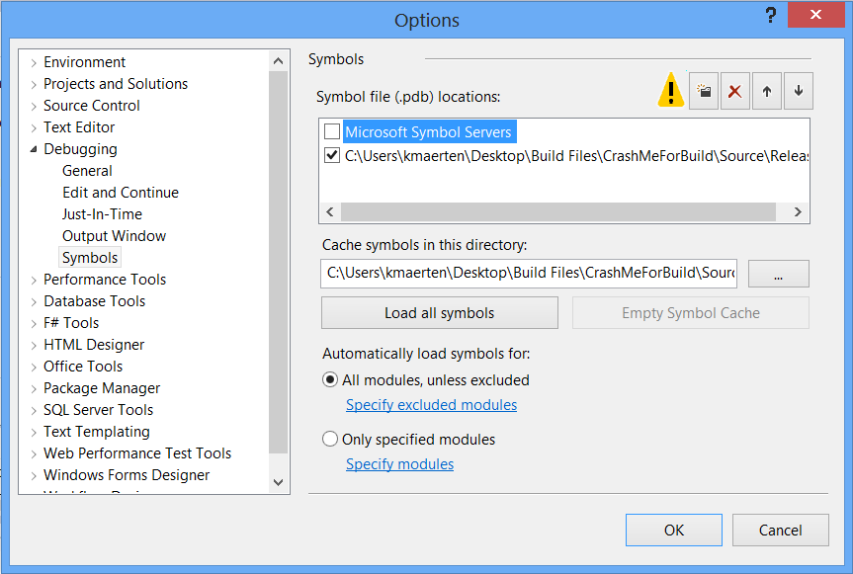

Slide 94
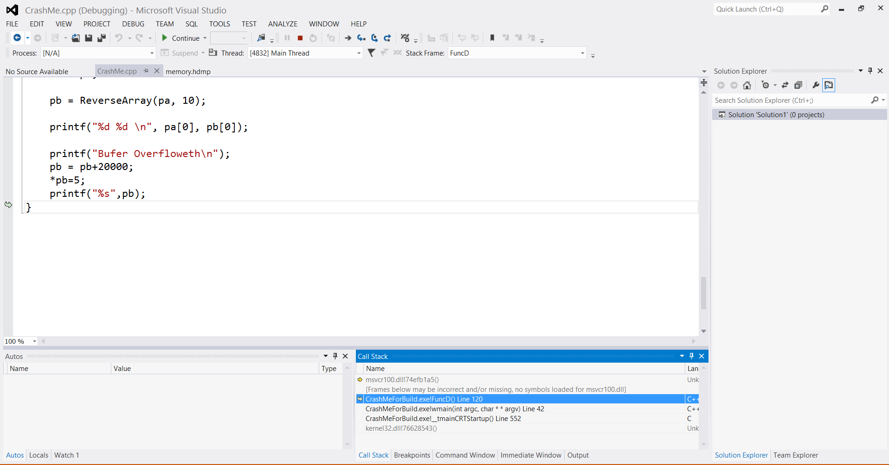

Slide 96
Drilling further with automation Demo: Report API

Slide 97
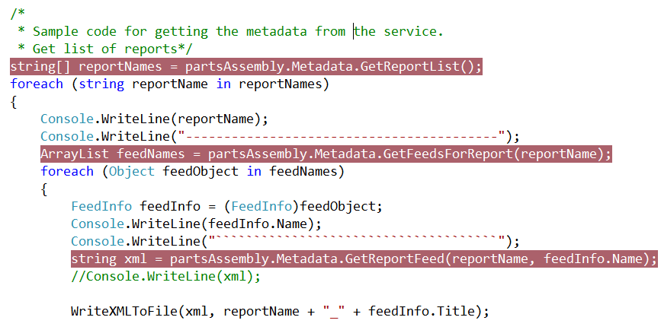
Automation API Code Sample
Automation White Paper

Slide 98
